Slide 1



Smart Irrigation System using AI and IoT
DONE BY:
RANGESHPANDIAN PT

Slide 2

Learning Objectives
Understand the use of AI in smart agriculture
Simulate real-time environmental conditions
Predict future soil moisture levels
Automate irrigation using intelligent control logic
Monitor battery, weather, and sensor status dynamically
Enhance water efficiency and decision making
GOAL
Source :
www.freepik.com/

Slide 3
Tools and Technology used
Programming Language: Python
Development Platform: Jupyter Notebook
Modules: random , logging , datetime
Documentation Tools: PowerPoint, Word
Optional Extensions: Firebase (cloud logs), Streamlit (dashboard), Raspberry Pi (real sensor deployment)

Slide 4
Methodology
Initialize system with soil moisture threshold
Simulate sensor data: soil moisture, battery level, and weather
Predict moisture trend using AI-inspired logic
Activate or deactivate the water pump based on logic
Trigger alerts for low moisture or battery
Log data and decisions for analysis
Repeat for multiple cycles to demonstrate system intelligence

Slide 5
Problem Statement:
Conventional irrigation systems lack real-time feedback and automation, leading to over-watering or under-watering of crops. This results in water wastage, low crop yield, and increased manual labor, especially in areas lacking smart infrastructure.

Slide 6
Solution:
A Python-based Smart Irrigation System that uses simulated sensors and AI logic to:
Predict moisture trends
Respond to environmental conditions
Automate irrigation with minimal manual input
Monitor battery status and weather for smarter control
Ensure sustainability and efficiency

Slide 7
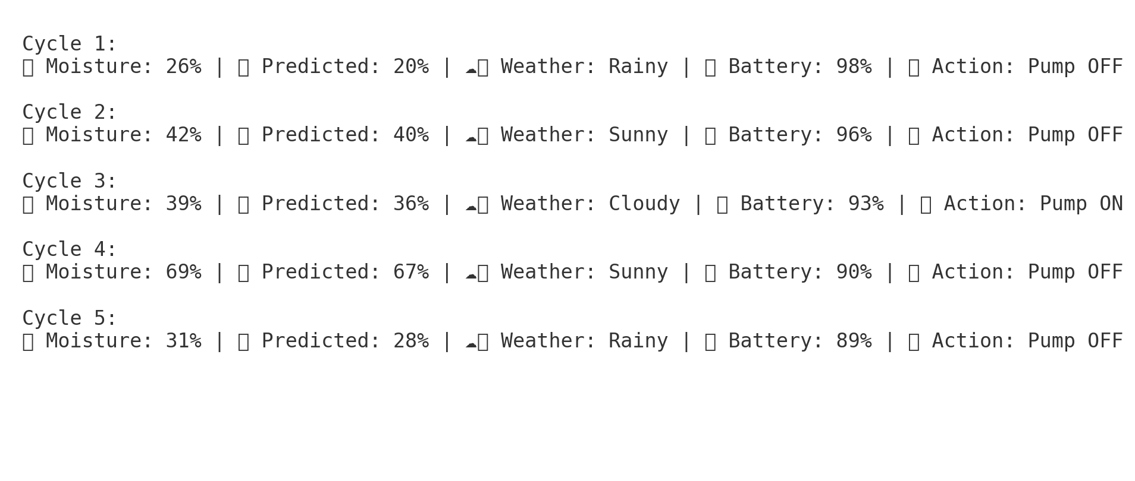
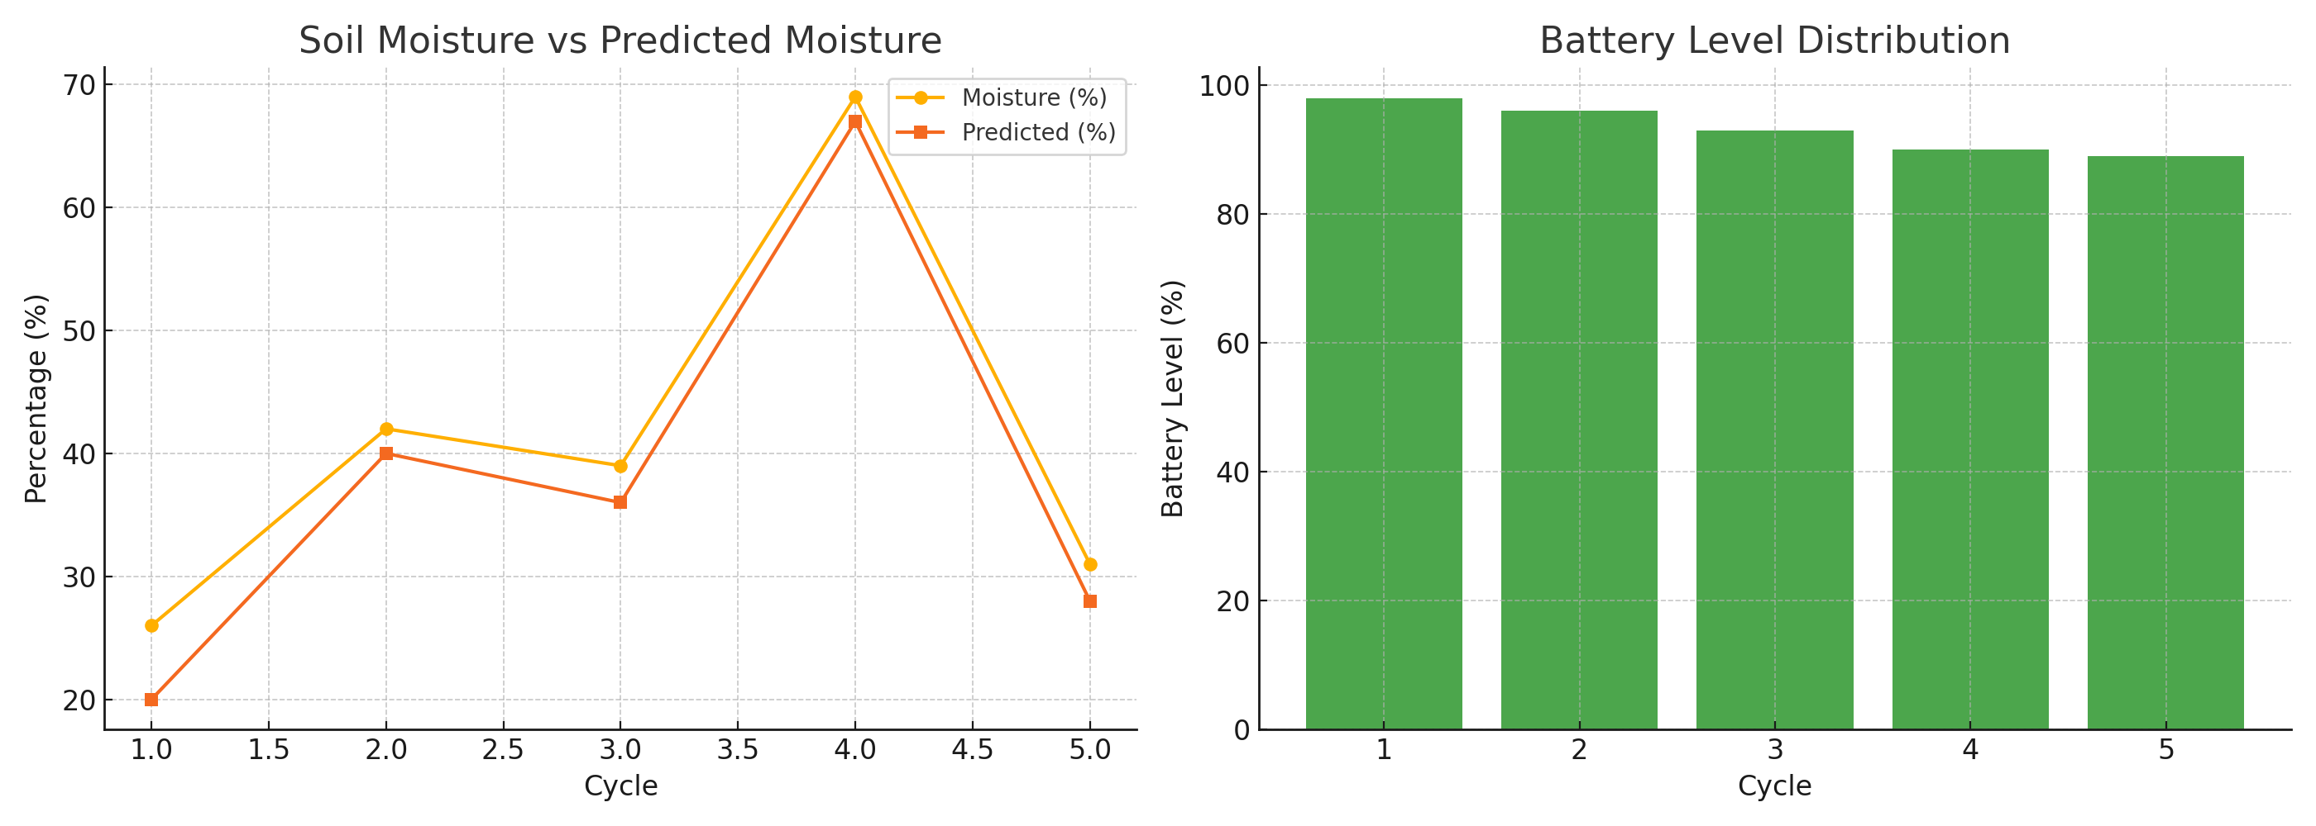
Screenshot of Output:

Slide 8
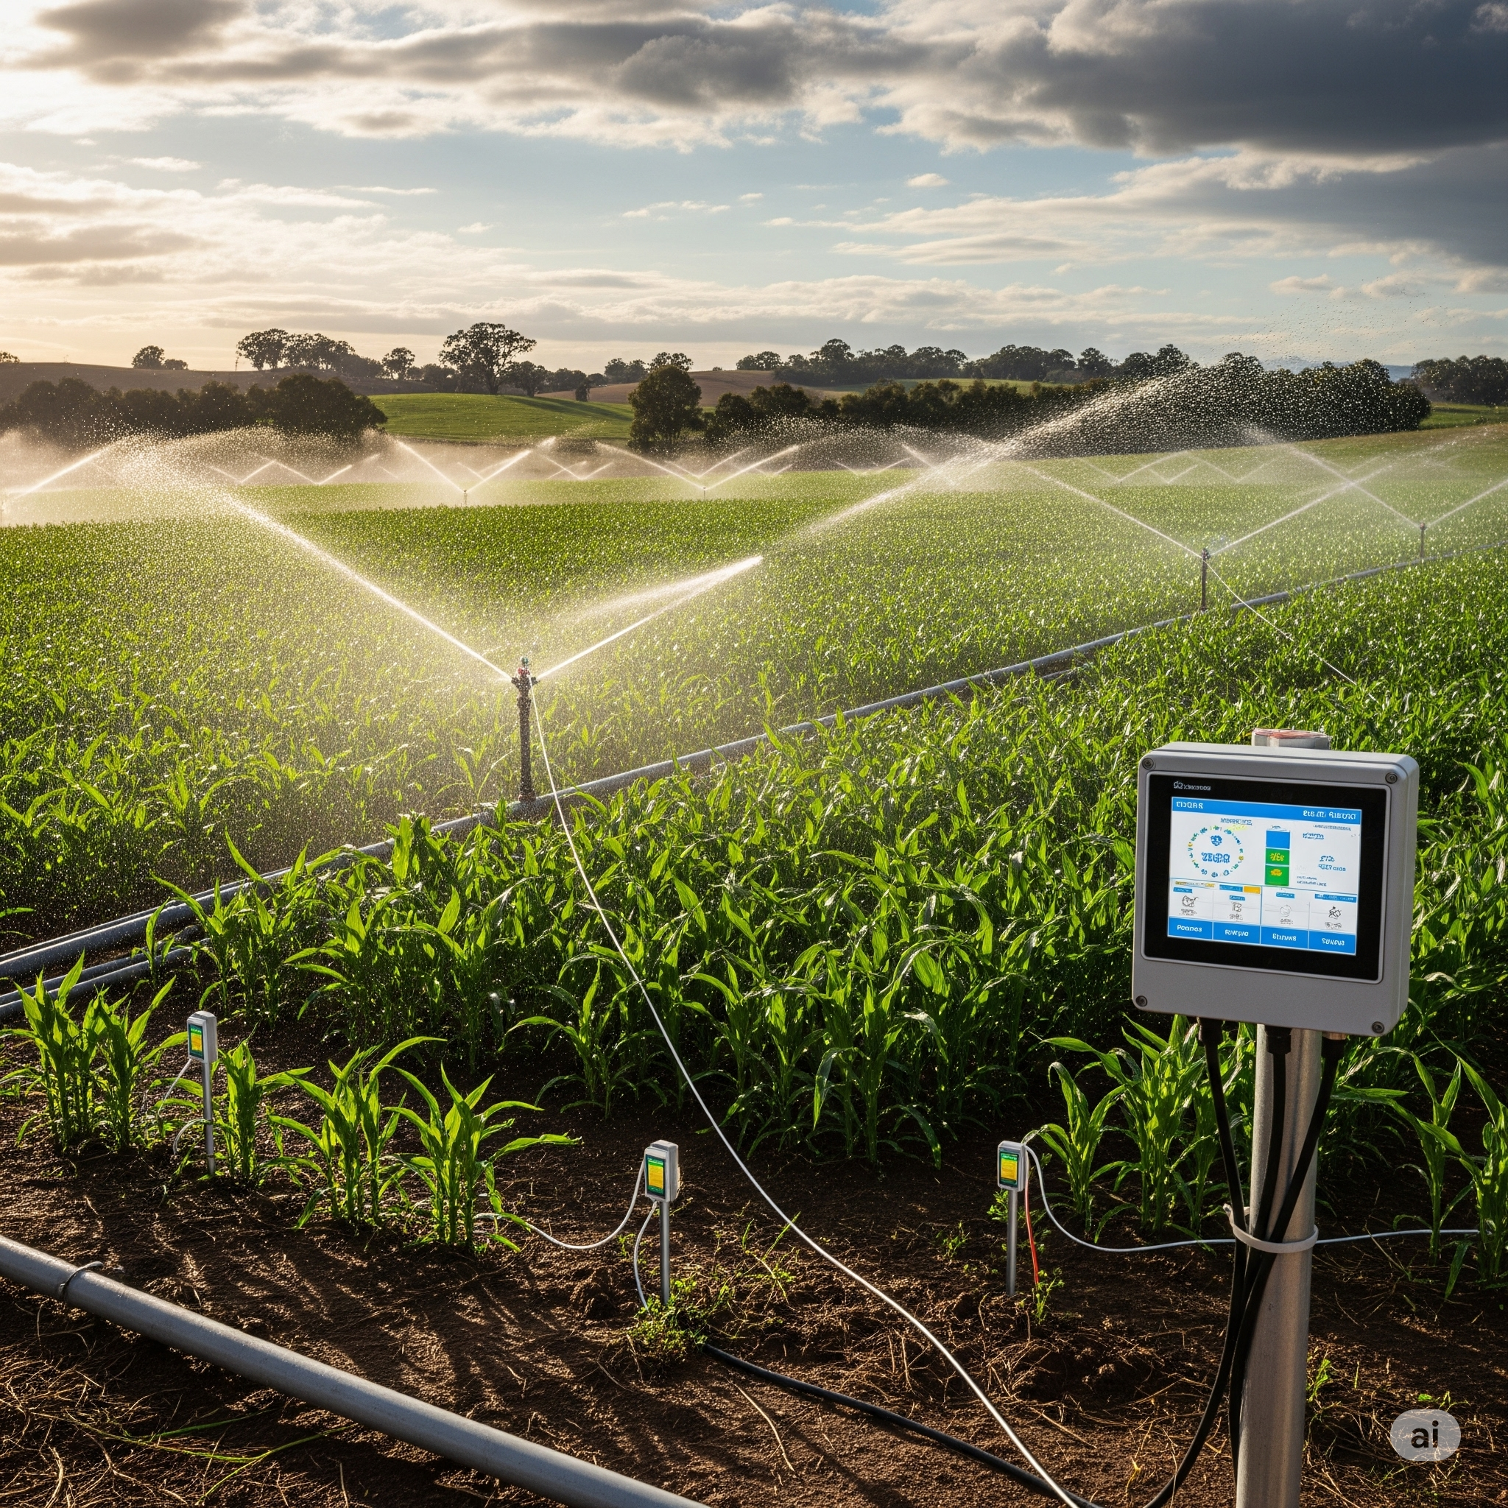
Conclusion:
The Smart Irrigation System provides a scalable and practical solution to agricultural water management using AI and IoT. It ensures timely irrigation based on predictive data, reduces water waste, and promotes sustainable farming. This project is a step toward modern, tech-enabled agriculture.

